Slide 1
iSLA-2025-(G##)-####-R##-WID.pptx
WI: SLB-mmW Meeting #### T2 Channel Model
Date: 2025 Mar 6-7
Source:
Affiliation | Contact | Email
Huawei Technologies. Co. Ltd | Tommi Jamsa | tommi.jamsa@huawei.com

For approval

For discussion
For information



Slide 2
Overview
During the Malaga meeting in January 2025, channel model options were introduced by Tommi.
Since the meeting was not able to make the decision, T2 Channel model was established.
We had two T2 calls: 12.2.2025 and 24.2.2025.
Participants: Ignacio, Theodoros, Dor, Tommi, Moray, Micky

Slide 3
Meeting 12.2.2025
Discussion
Ignacio: Wideband validation is very time consuming.
Moray: Channel model. How much can we do within SL project?
IEEE and 3GPP totally different. IEEE designed for 60 GHz, 3GPP extended from low frequency. Prefer IEEE.
Tommi: What we try to achieve (scenario-wise), is a bit different from 3GPP.
Dor: Second what Moray said. Simulations done for IEEE model already. IEEE pinpoint scenarios and frequency band.
Ignacio: Agree. IEEE better suitable for 60 GHz and iSLA scenarios.
Dor: Procedure suggestion. Temprorary decision to use IEEE. Evaluate it and make the decision.
Theodoros: Agree with Dor.
Dor: For outdoor scenarios perhaps 3GPP better. For indoor, IEEE looks better.
Moray: What is the use for channel model? Design or performance measurement? Channel model is an estimate of reality, but not reality. If we test against the model, it is the second step of uncertainty.
Tommi: At this stage we focuss on link and system level simulations
T2 meeting suggests: Temprorary decision to use IEEE. Each of us should study the model bring input to the next meeting it and make the decision.

Slide 4
Meeting 12.2.2025, Next Steps
T2 to discuss the channel model alternatives
IEEE 802.11ay
3GPP TR38.901
T2 meeting suggests: Temprorary decision to use IEEE. Each of us should study the model bring input to the next meeting it and make the decision.
Moray picked up a 3GPP document about the use of 3GPP in mmW. Channel sparsity. Moray will introduce it in the next meeting.
Dor will put some effort on learning IEEE from the simulation aspects.
Ignacio scenario vectors based on the use case vectors / reflect them to IEEE/3GPP.
Theo: Overview on 3GPP vs IEEE, theoretical part
Tommi: Further study on IEEE channel modeling principle and scenarios, TR prepartions.
One more call before Barcelona. 24 Feb 12:00 CET (19:00 China)

Slide 5
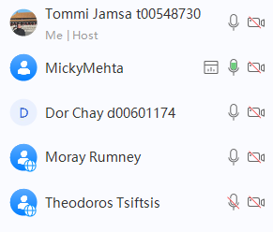
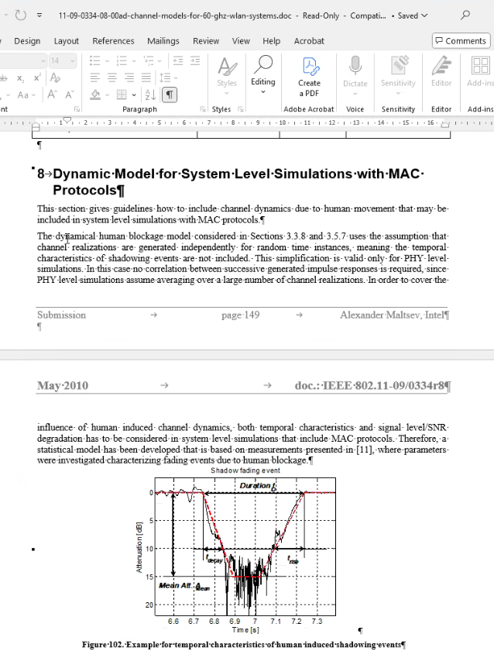
Meeting 24.2.2025
Presentation by Dor.
11ay should be backwards compatible with 11ad (to be double-checked)
11ad there are some issue on human shadowing during the time of standard development. Literature review needed.
Gap analysis on other aspects as well.
Impact of beamforming on the sensitivity/severity of channel model?
Polarization
Duty cycle
Working assumption: Simulation is Stand Alone mmW, but the operation is NSA.
Presentation by Moray. Two (unsent) LSs.
R4-1708555. The number of clusters is too high.
R4-1706876
SNR-based cost function instead of assuming maximum antenna gain. SNR is better that RSRP . Closed loop channel sounding is needed for maximum antenna gain.
Link budget TBC.
T2 meeting suggests: Temprorary decision to use IEEE 11ad/ay. Details to be confirmed. Each of us should study the model bring input to the next meeting.

Slide 6
Items for discussion and decision
T2 meeting suggests: Temprorary decision to use IEEE 11ad/ay. Details to be confirmed. Each of us should study the model bring input to the next meeting.
Open issue whether T2 should be nenamed as AHG4.

Slide 7
Thank you

